Slide 1

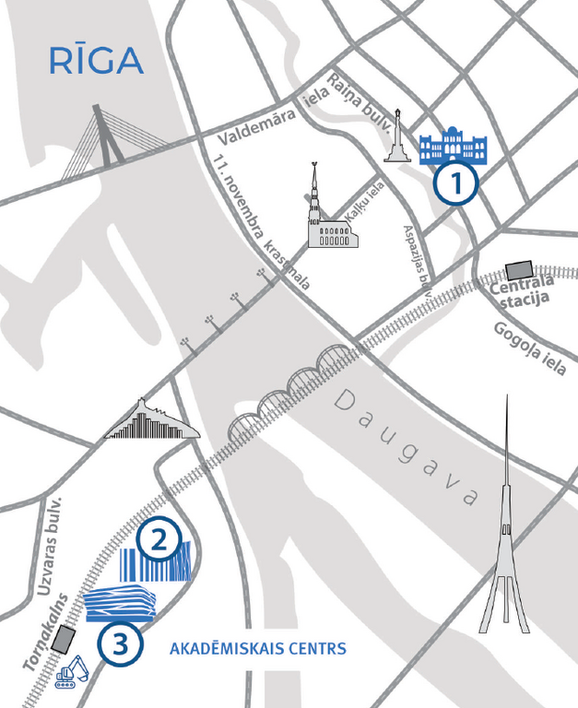

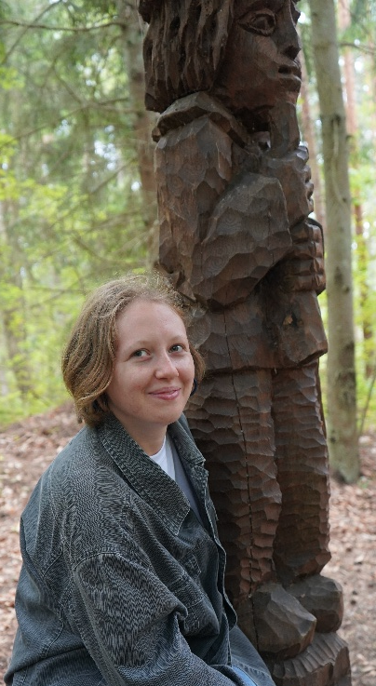
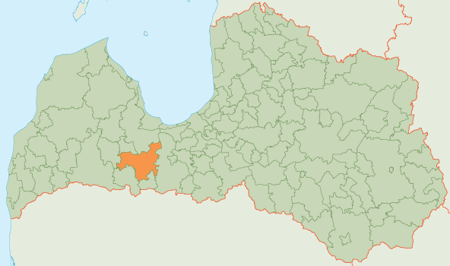


Līga Blumfelde
University: University of Latvia, Riga Technical Univeristy
Study program: Biotechnology and Bioengineering
Year of study: 3rd semester
City: Riga, Latvia
Motto for life: What, like it’s hard? Yes, very hard, but gotta do anyway.
Hobbies: Learning fun facts about animals, reading
Your expectations from the summer school:
Connect with many enthusiastic people, learn how to make the world more sustainable
Location where I study,
and where I live
Karlsruhe
31 August to 11 September 2026

